Slide 1
MSDM 5003 Lecture 10 16 November 2023 Modeling Asset Exchange
Outline:
1. Kinetic theory of gases
2. The asset exchange model of wealth distribution
Random sharing model
Model with uniform savings
Model with non-uniform savings
3. Comparison with real data
4. A minimal model of interacting selfish agents

Slide 2
1. Kinetic Theory of Gases
Exploring Complex Distributions with Simple Models (Econophysics Chapter 8)
Complex distributions: macroscopic
Simple models: microscopic agent-based models
The approach of using a molecule-based model to explain macroscopic phenomena is best illustrated by the kinetic theory of gases, which explains the distribution of energy of molecules.
Subsequently, we will adopt this approach to explain the distribution of wealth.

Slide 3
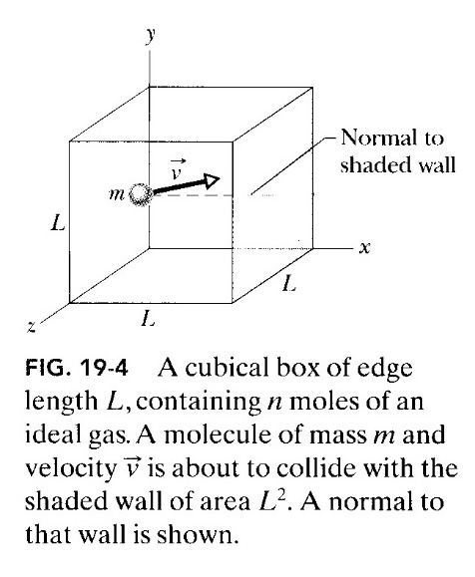
Kinetic Theory Explaining Pressure
Consider n moles of an ideal gas in a cubical box of volume V at temperature T.
The gas molecules are moving in the box.
When they collide with the walls, the collision is elastic and momentum is transferred to the walls.
Using Newton’s second law, this change in momentum results in a force acting on the wall.
This force contributes to the pressure of the gas.

Slide 4
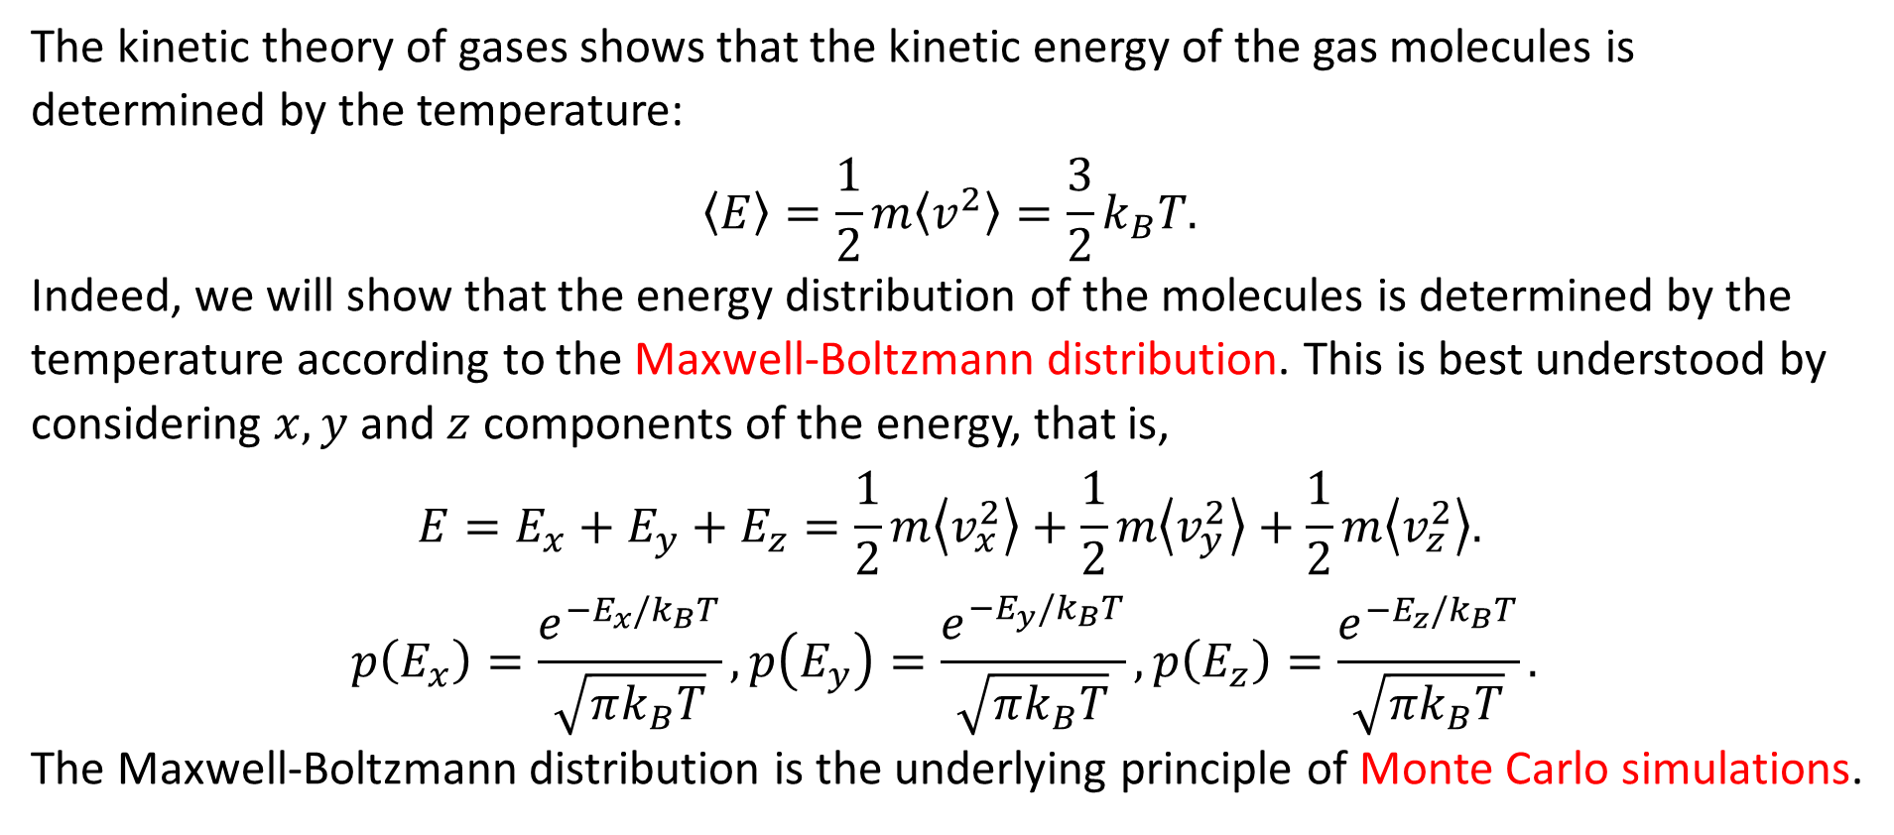
Relating Temperature with Molecular Energy
The kinetic theory of gases shows that the kinetic energy of the gas molecules is determined by the temperature:
$$〈E〉=\frac{1}{2}m〈v^{2}〉=\frac{3}{2}k_{B}T.$$
Indeed, we will show that the energy distribution of the molecules is determined by the temperature according to the Maxwell-Boltzmann distribution. This is best understood by considering $x, y$ and $z$ components of the energy, that is,
$$E=E_{x}+E_{y}+E_{z}=\frac{1}{2}m\left\langle v_{x}^{2}\right\rangle +\frac{1}{2}m\left\langle v_{y}^{2}\right\rangle +\frac{1}{2}m\left\langle v_{z}^{2}\right\rangle .$$
$$p\left(E_{x}\right)=\frac{e^{−E_{x}/k_{B}T}}{\sqrt{πk_{B}T}}, p\left(E_{y}\right)=\frac{e^{−E_{y}/k_{B}T}}{\sqrt{πk_{B}T}},p\left(E_{z}\right)=\frac{e^{−E_{z}/k_{B}T}}{\sqrt{πk_{B}T}}.$$
The Maxwell-Boltzmann distribution is the underlying principle of Monte Carlo simulations.

Slide 5
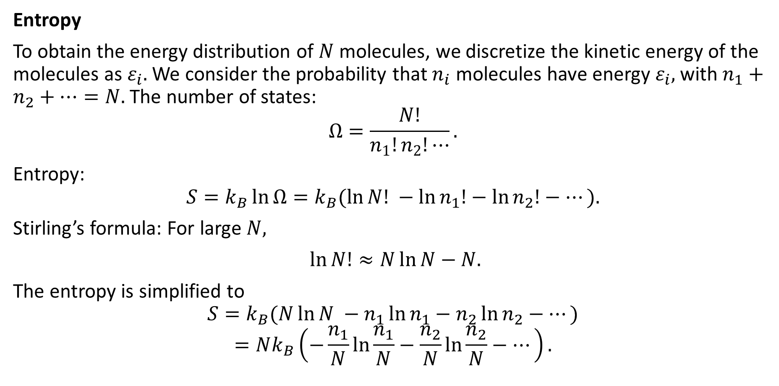
Energy Distribution: Maximum Entropy
Entropy
To obtain the energy distribution of $N$ molecules, we discretize the kinetic energy of the molecules as $ε_{i}.$ We consider the probability that $n_{i}$ molecules have energy $ε_{i},$ with $n_{1}+n_{2}+⋯=N.$ The number of states:
$$Ω=\frac{N!}{n_{1}!n_{2}!⋯}.$$
Entropy:
$$S=k_{B}\ln{Ω}=k_{B}(\ln{N! }−\ln{n_{1}!}−\ln{n_{2}!}−⋯).$$
Stirling’s formula: For large $N,$
$\ln{N!}≈N\ln{N}−N.$
The entropy is simplified to
$$S=k_{B}(N\ln{N }−n_{1}\ln{n_{1}}−n_{2}\ln{n_{2}}−⋯)$$
$$=Nk_{B}\left(−\frac{n_{1}}{N}\ln{\frac{n_{1}}{N}}−\frac{n_{2}}{N}\ln{\frac{n_{2}}{N}}−⋯\right).$$

Slide 6
An Analogy of Maximum Entropy: The Haunted Castle
The situation is like a drunken ghost wondering inside a haunted castle with many rooms of different sizes. (It can penetrate all walls.)
Even if he starts from a small room, he will most likely be located in the room with the largest area after a long time.
The largest room corresponds to the macrostate having the largest number of microstates.

Slide 7
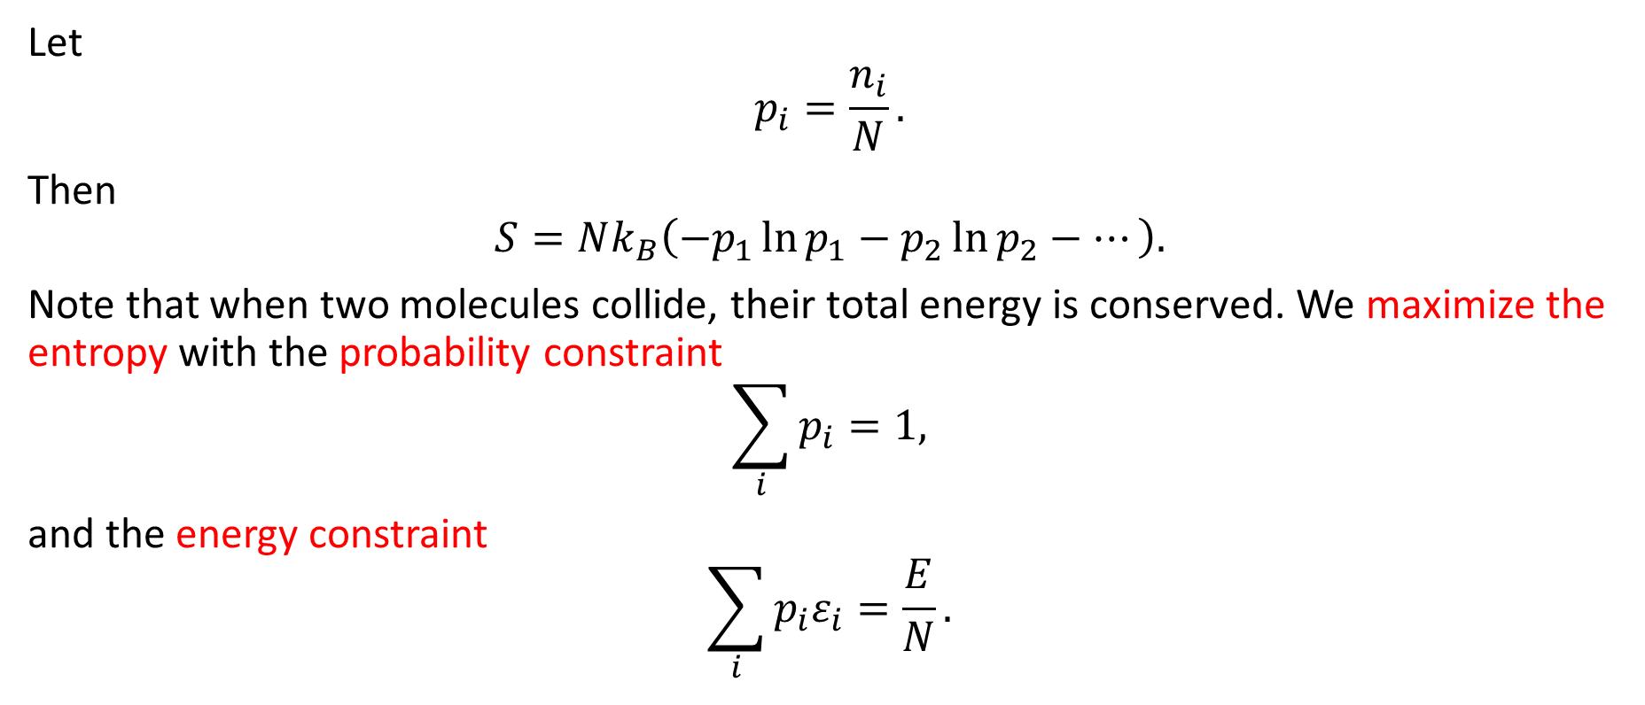
Boltzmann Distribution of Molecular Speeds
Let
$$p_{i}=\frac{n_{i}}{N}.$$
Then
$$S=Nk_{B}\left(−p_{1}\ln{p_{1}}−p_{2}\ln{p_{2}}−⋯\right).$$
Note that when two molecules collide, their total energy is conserved. We maximize the entropy with the probability constraint
$$\sum_{i}{p_{i}}=1,$$
and the energy constraint
$$\sum_{i}{p_{i}ε_{i}}=\frac{E}{N}.$$

Slide 8
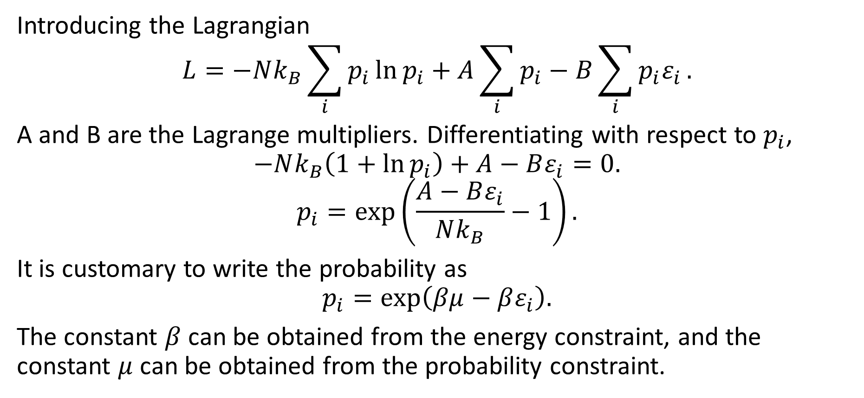
Constrained Maximization of Entropy
Introducing the Lagrangian
$$L=−Nk_{B}\sum_{i}{p_{i}\ln{p_{i}}}+A\sum_{i}{p_{i}}−B\sum_{i}{p_{i}ε_{i}}.$$
A and B are the Lagrange multipliers. Differentiating with respect to $p_{i}$,
$$−Nk_{B}\left(1+\ln{p_{i}}\right)+A−Bε_{i}=0.$$
$$p_{i}=\exp\left(\frac{A−Bε_{i}}{Nk_{B}}−1\right).$$
It is customary to write the probability as
$$p_{i}=\exp\left(βμ−βε_{i}\right).$$
The constant $β$ can be obtained from the energy constraint, and the constant $μ$ can be obtained from the probability constraint.

Slide 9


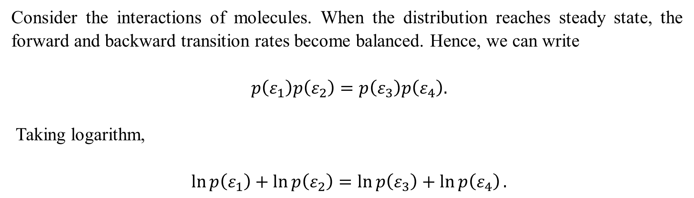


An Intuitive Argument for the Boltzmann Distribution
$$ε_{1}$$
$$ε_{3}$$
$$ε_{2}$$
$$ε_{4}$$
Consider the interactions of molecules. When the distribution reaches steady state, the forward and backward transition rates become balanced. Hence, we can write
$p\left(ε_{1}\right)p\left(ε_{2}\right)=p\left(ε_{3}\right)p\left(ε_{4}\right).$
Taking logarithm,
$\ln{p\left(ε_{1}\right)}+\ln{p\left(ε_{2}\right)}=\ln{p\left(ε_{3}\right)}+\ln{p\left(ε_{4}\right)}.$

Slide 10
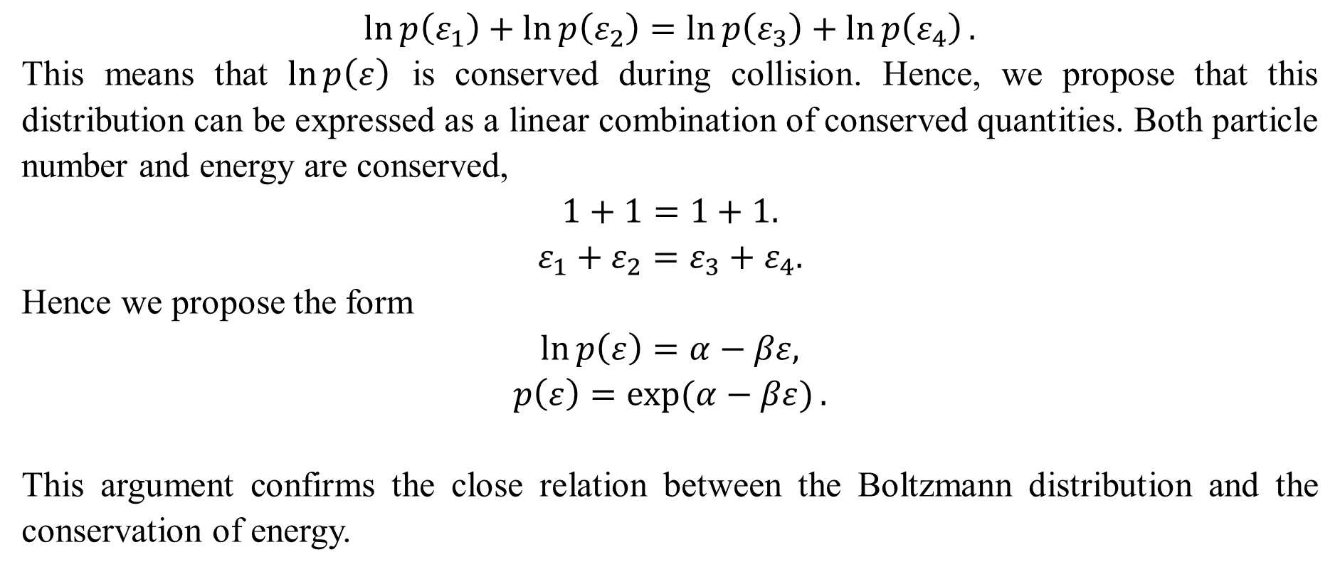
Argument from the Conserved Quantities
$$\ln{p\left(ε_{1}\right)}+\ln{p\left(ε_{2}\right)}=\ln{p\left(ε_{3}\right)}+\ln{p\left(ε_{4}\right)}.$$
This means that $\ln{p\left(ε\right)}$ is conserved during collision. Hence, we propose that this distribution can be expressed as a linear combination of conserved quantities. Both particle number and energy are conserved,
$$1+1=1+1.$$
$$ε_{1}+ε_{2}=ε_{3}+ε_{4}.$$
Hence we propose the form
$$\ln{p\left(ε\right)}=α−βε,$$
$$p\left(ε\right)=\exp{(α−βε)}.$$
This argument confirms the close relation between the Boltzmann distribution and the conservation of energy.

Slide 11
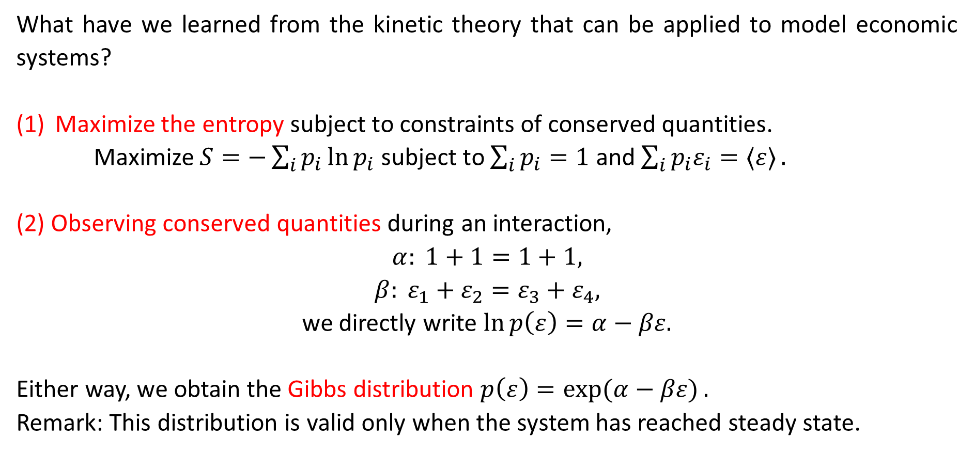
Summary
What have we learned from the kinetic theory that can be applied to model economic systems?
Maximize the entropy subject to constraints of conserved quantities.
Maximize $S=−\sum_{i}{p_{i}\ln{p_{i}}}$ subject to $\sum_{i}{p_{i}=1}$ and $\sum_{i}{p_{i}ε_{i}=〈ε〉}.$
(2) Observing conserved quantities during an interaction,
$$α: 1+1=1+1,$$
$$β: ε_{1}+ε_{2}=ε_{3}+ε_{4},$$
we directly write $\ln{p\left(ε\right)}=α−βε.$
Either way, we obtain the Gibbs distribution $p\left(ε\right)=\exp{(α−βε)}.$
Remark: This distribution is valid only when the system has reached steady state.

Slide 12
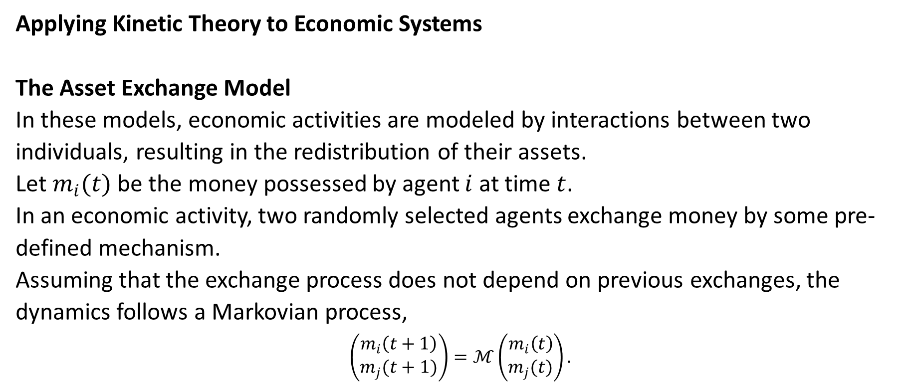
2. The Asset Exchange Model of Wealth Distribution
Applying Kinetic Theory to Economic Systems
The Asset Exchange Model
In these models, economic activities are modeled by interactions between two individuals, resulting in the redistribution of their assets.
Let $m_{i}(t)$ be the money possessed by agent $i$ at time $t$.
In an economic activity, two randomly selected agents exchange money by some pre-defined mechanism.
Assuming that the exchange process does not depend on previous exchanges, the dynamics follows a Markovian process,
$$\left(\begin{matrix}m_{i}\left(t+1\right) \\ m_{j}(t+1)\end{matrix}\right)=ℳ\left(\begin{matrix}m_{i}\left(t\right) \\ m_{j}(t)\end{matrix}\right).$$

Slide 13
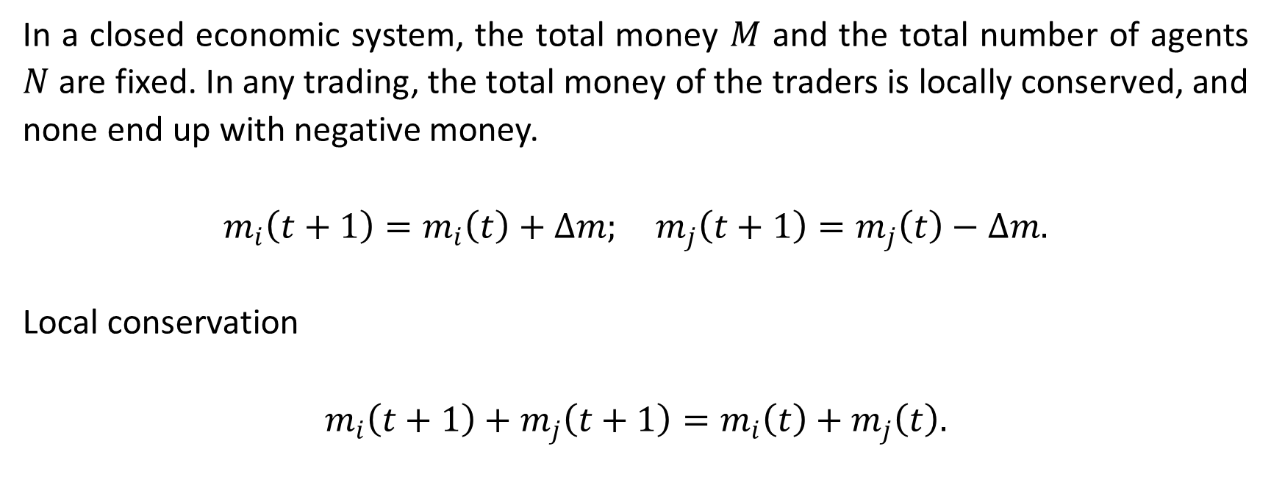
Conservation of Money
In a closed economic system, the total money $M$ and the total number of agents $N$ are fixed. In any trading, the total money of the traders is locally conserved, and none end up with negative money.
$$m_{i}\left(t+1\right)=m_{i}\left(t\right)+Δm; m_{j}\left(t+1\right)=m_{j}\left(t\right)−Δm.$$
Local conservation
$$m_{i}\left(t+1\right)+m_{j}\left(t+1\right)=m_{i}\left(t\right)+m_{j}\left(t\right).$$

Slide 14
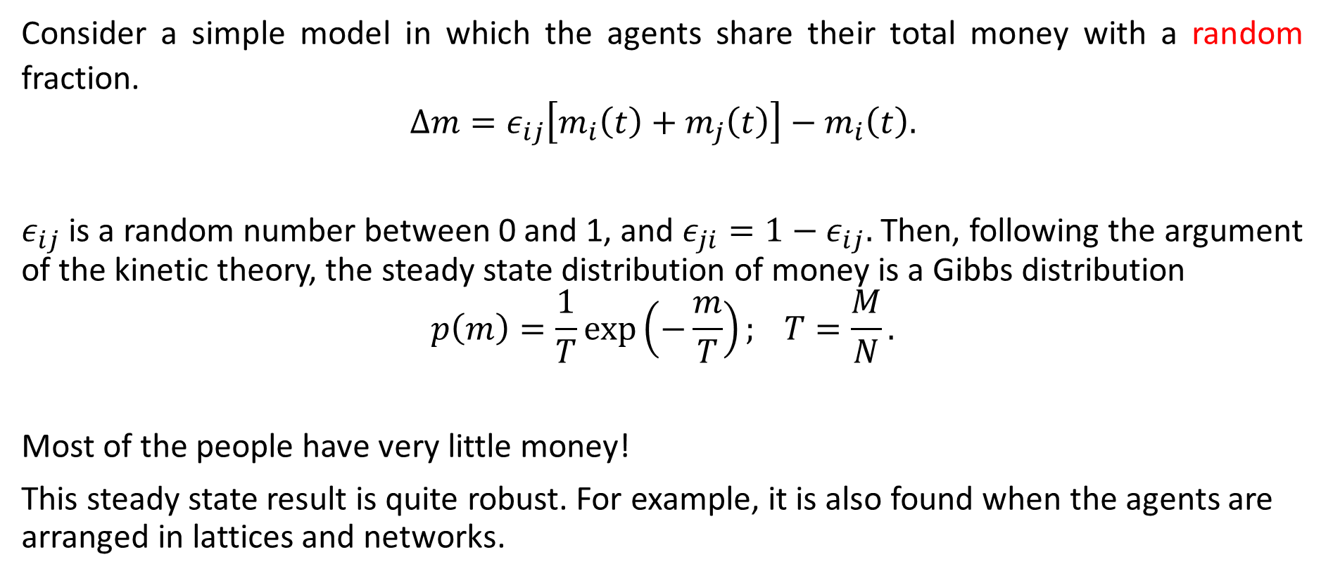
Random Sharing Model
Consider a simple model in which the agents share their total money with a random fraction.
$$Δm=ε_{ij}\left[m_{i}\left(t\right)+m_{j}\left(t\right)\right]−m_{i}\left(t\right).$$
$ε_{ij}$ is a random number between 0 and 1, and $ε_{ji}=1−ε_{ij}.$ Then, following the argument of the kinetic theory, the steady state distribution of money is a Gibbs distribution
$$p\left(m\right)=\frac{1}{T}\exp\left(−\frac{m}{T}\right); T=\frac{M}{N}.$$
Most of the people have very little money!
This steady state result is quite robust. For example, it is also found when the agents are arranged in lattices and networks.

Slide 15
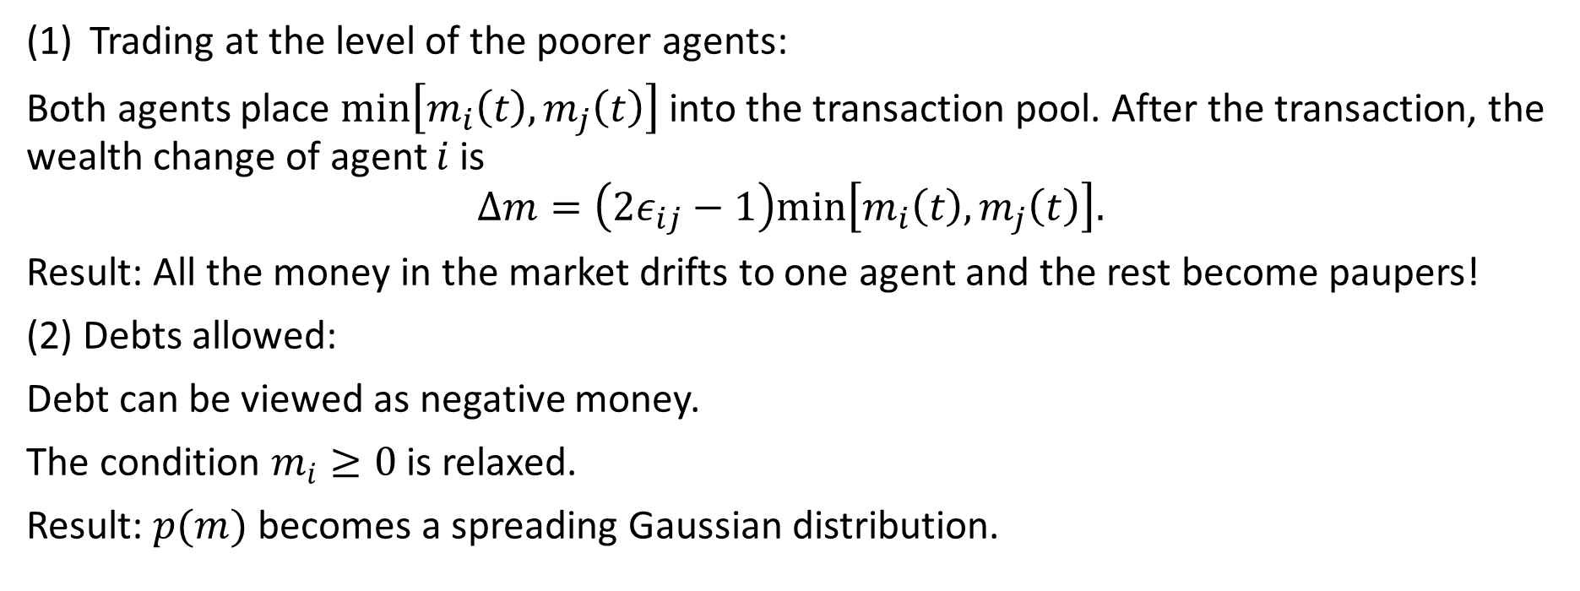
Other Versions
Trading at the level of the poorer agents:
Both agents place $min\left[m_{i}\left(t\right),m_{j}\left(t\right)\right]$ into the transaction pool. After the transaction, the wealth change of agent $i$ is
$$Δm=\left(2ε_{ij}−1\right)min\left[m_{i}\left(t\right),m_{j}\left(t\right)\right].$$
Result: All the money in the market drifts to one agent and the rest become paupers!
(2) Debts allowed:
Debt can be viewed as negative money.
The condition $m_{i}≥0$ is relaxed.
Result: $p(m)$ becomes a spreading Gaussian distribution.

Slide 16
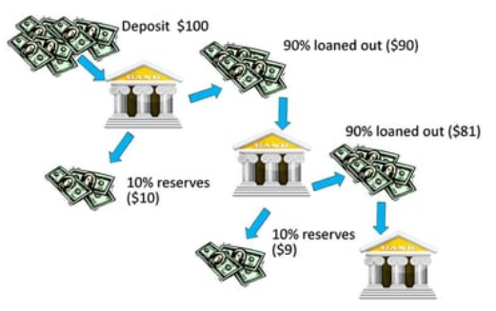
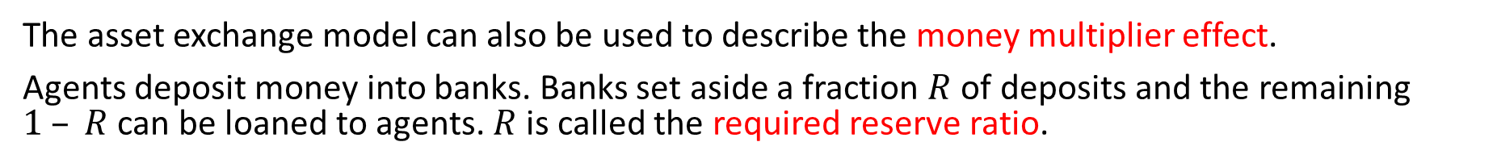
Money Multiplier Effect¹
The asset exchange model can also be used to describe the money multiplier effect.
Agents deposit money into banks. Banks set aside a fraction $R$ of deposits and the remaining $1 – R$ can be loaned to agents. $R$ is called the required reserve ratio.
¹ Ning Xi, Ning Ding, Yougui Wang (2005). How required reserve ratio affects distribution and velocity of money. Physica A 357 543-555.

Slide 17
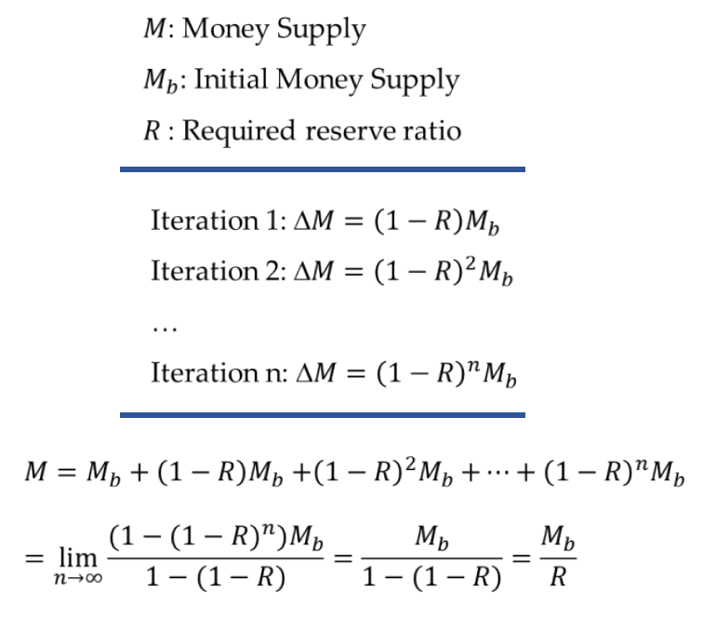
Repeated Circulation of Money

Slide 18


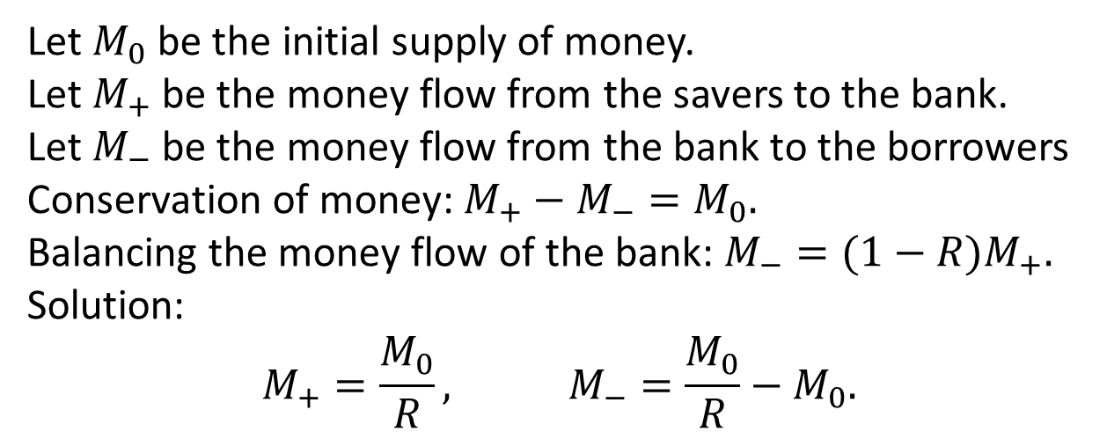


Bank
$$M_{+}$$
$$M_{−}$$
Loan out
$$M_{−}$$
Reserve
$${RM}_{+}$$
Asset exchange
Savers
Borrowers
Let $M_{0}$ be the initial supply of money.
Let $M_{+}$ be the money flow from the savers to the bank.
Let $M_{−}$ be the money flow from the bank to the borrowers Conservation of money: $M_{+}−M_{−}=M_{0}.$
Balancing the money flow of the bank: $M_{−}=(1−R)M_{+}.$
Solution:
$$M_{+}=\frac{M_{0}}{R}, M_{−}=\frac{M_{0}}{R}−M_{0}.$$

Slide 19
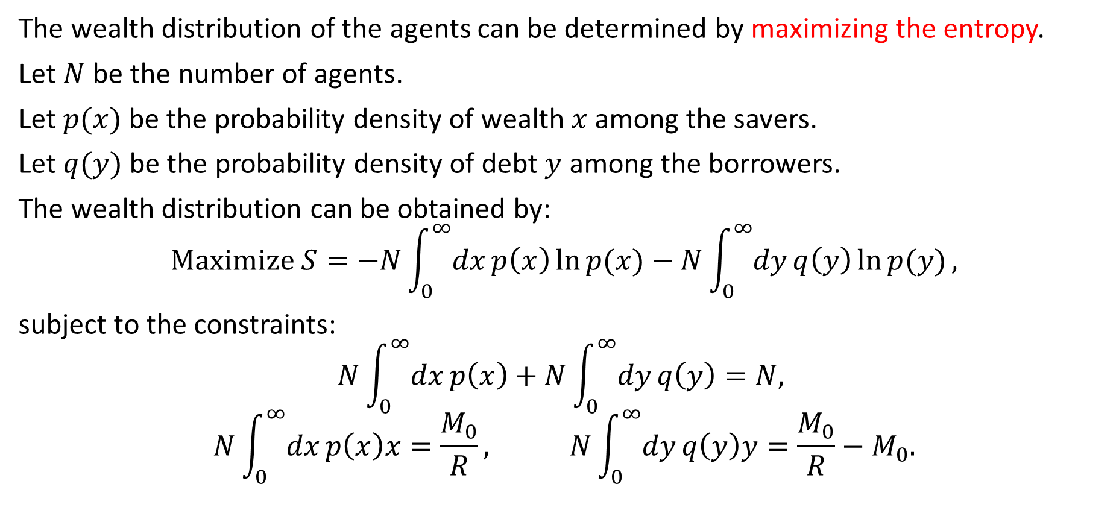
Wealth Distribution
The wealth distribution of the agents can be determined by maximizing the entropy.
Let $N$ be the number of agents.
Let $p(x)$ be the probability density of wealth $x$ among the savers.
Let $q(y)$ be the probability density of debt $y$ among the borrowers.
The wealth distribution can be obtained by:
$$Maximize S=−N\int_{0}^{∞}{dx}p\left(x\right)\ln{p(x)}−N\int_{0}^{∞}{dy}q\left(y\right)\ln{p(y)},$$
subject to the constraints:
$$N\int_{0}^{∞}{dx}p\left(x\right)+N\int_{0}^{∞}{dy}q\left(y\right)=N,$$
$$N\int_{0}^{∞}{dx}p\left(x\right)x=\frac{M_{0}}{R}, N\int_{0}^{∞}{dy}q\left(y\right)y=\frac{M_{0}}{R}−M_{0}.$$

Slide 20
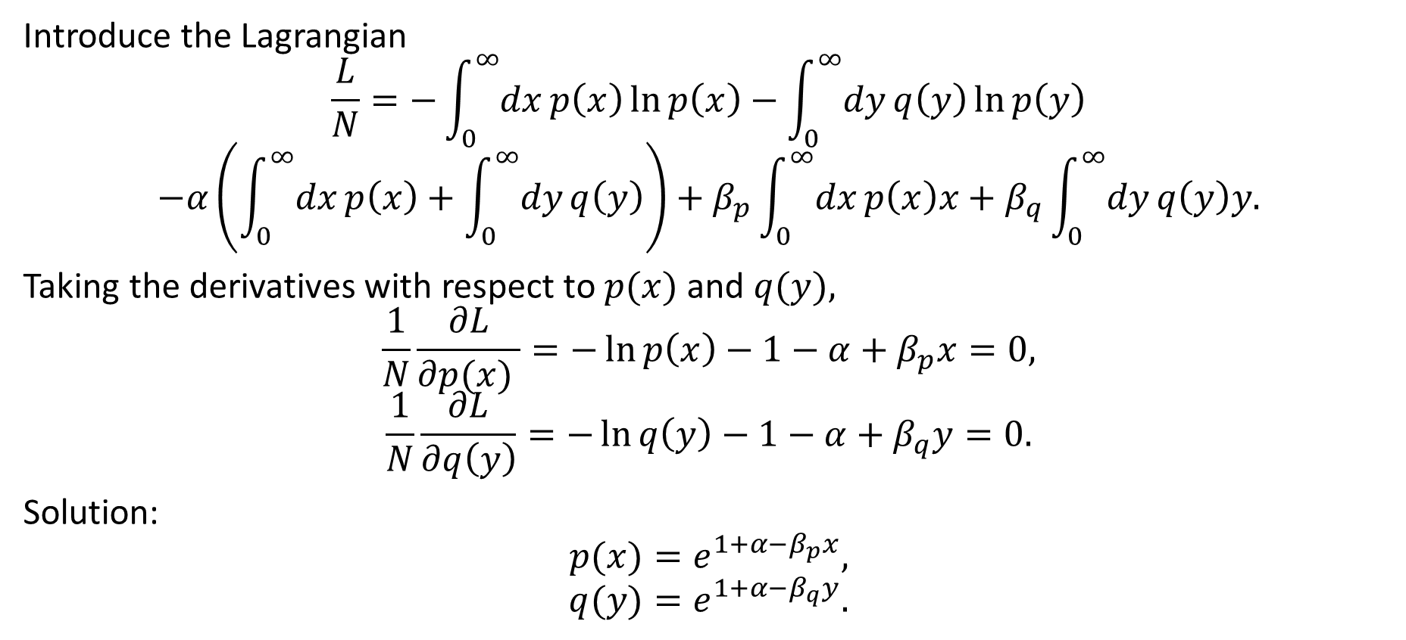
Maximum Entropy
Introduce the Lagrangian
$$\frac{L}{N}=−\int_{0}^{∞}{dx}p\left(x\right)\ln{p\left(x\right)}−\int_{0}^{∞}{dy}q\left(y\right)\ln{p\left(y\right)}$$
$$−α\left(\int_{0}^{∞}{dx}p\left(x\right)+\int_{0}^{∞}{dy}q\left(y\right)\right)+β_{p}\int_{0}^{∞}{dx}p\left(x\right)x+β_{q}\int_{0}^{∞}{dy}q\left(y\right)y.$$
Taking the derivatives with respect to $p(x)$ and $q(y),$
$$\frac{1}{N}\frac{∂L}{∂p(x) }=−\ln{p\left(x\right)}−1−α+β_{p}x=0,$$
$$\frac{1}{N}\frac{∂L}{∂q\left(y\right)}=−\ln{q\left(y\right)}−1−α+β_{q}y=0.$$
Solution:
$$p(x)=e^{1+α−β_{p}x},$$
$$q(y)=e^{1+α−β_{q}y}.$$

Slide 21
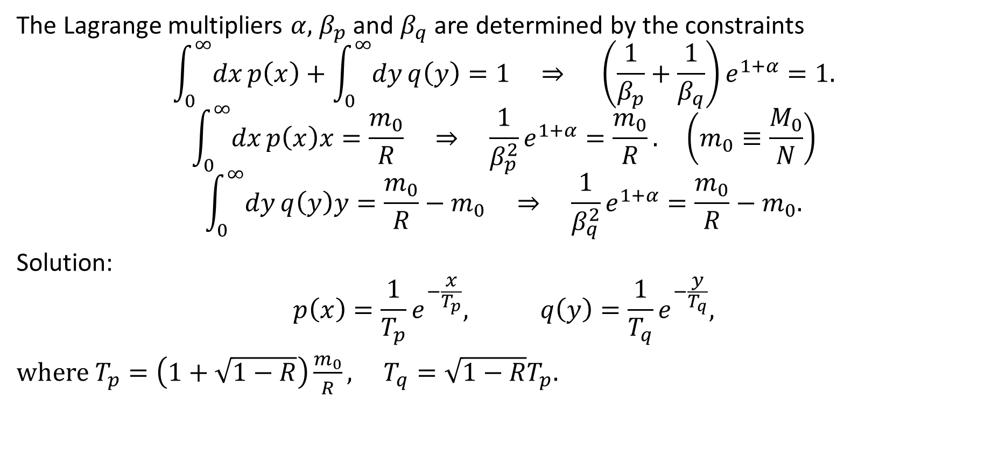
Lagrange Multipliers
The Lagrange multipliers $α,$ $β_{p}$ and $β_{q}$ are determined by the constraints
$$\int_{0}^{∞}{dx}p\left(x\right)+\int_{0}^{∞}{dy}q\left(y\right)=1 ⇒ \left(\frac{1}{β_{p}}+\frac{1}{β_{q}}\right)e^{1+α}=1.$$
$$\int_{0}^{∞}{dx}p\left(x\right)x=\frac{m_{0}}{R} ⇒ \frac{1}{β_{p}^{2}}e^{1+α}=\frac{m_{0}}{R}. \left(m_{0}≡\frac{M_{0}}{N}\right)$$
$$\int_{0}^{∞}{dy}q\left(y\right)y=\frac{m_{0}}{R}−m_{0} ⇒ \frac{1}{β_{q}^{2}}e^{1+α}=\frac{m_{0}}{R}−m_{0}.$$
Solution:
$$p\left(x\right)=\frac{1}{T_{p}}e^{−\frac{x}{T_{p}}}, q\left(y\right)=\frac{1}{T_{q}}e^{−\frac{y}{T_{q}}},$$
where $T_{p}=\left(1+\sqrt{1−R}\right)\frac{m_{0}}{R}, T_{q}=\sqrt{1−R}T_{p}.$

Slide 22
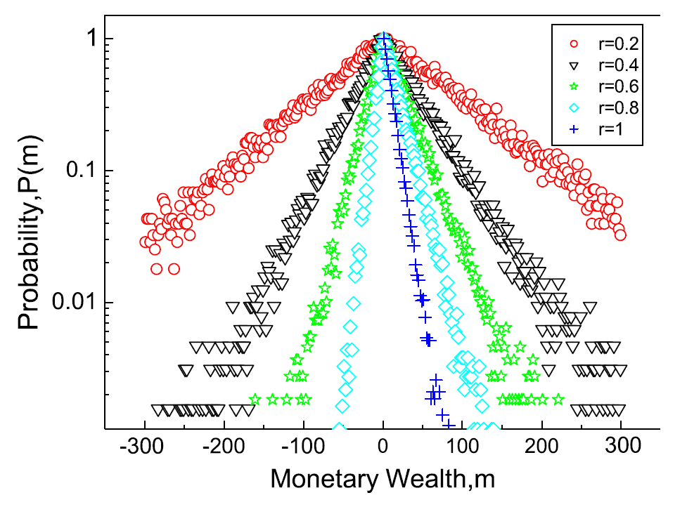
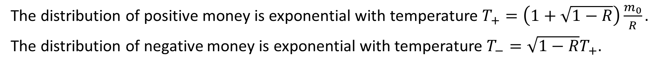
Wealth Distribution
The distribution of positive money is exponential with temperature $T_{+}=\left(1+\sqrt{1−R}\right)\frac{m_{0}}{R}.$
The distribution of negative money is exponential with temperature $T_{−}=\sqrt{1−R}T_{+}.$

Slide 23
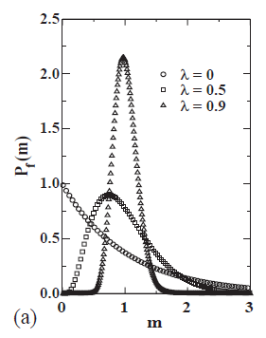
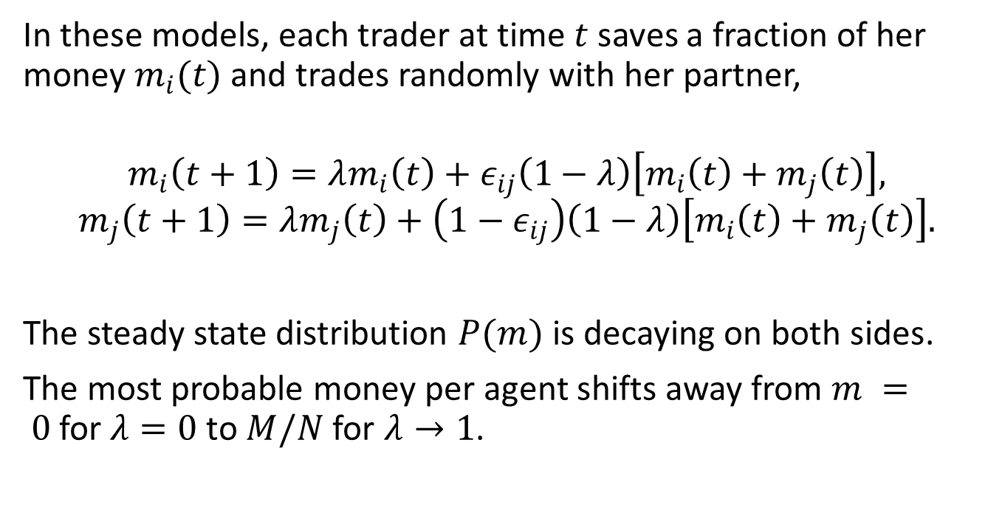
Models with Uniform Savings²
In these models, each trader at time $t$saves a fraction of her money $m_{i}(t)$ and trades randomly with her partner,
$$m_{i}\left(t+1\right)=λm_{i}\left(t\right)+ε_{ij}\left(1−λ\right)\left[m_{i}\left(t\right)+m_{j}\left(t\right)\right],$$
$$m_{j}\left(t+1\right)=λm_{j}\left(t\right)+\left(1−ε_{ij}\right)\left(1−λ\right)\left[m_{i}\left(t\right)+m_{j}\left(t\right)\right].$$
The steady state distribution $P(m)$ is decaying on both sides.
The most probable money per agent shifts away from $m = 0$for $λ=0$ to $M/N$ for $λ→1$.
² Chatterjee A, Chakrabarti BK, Manna SS (2004). Pareto law in a kinetic model of market with random saving propensity. Physica A 335 155–163.

Slide 24
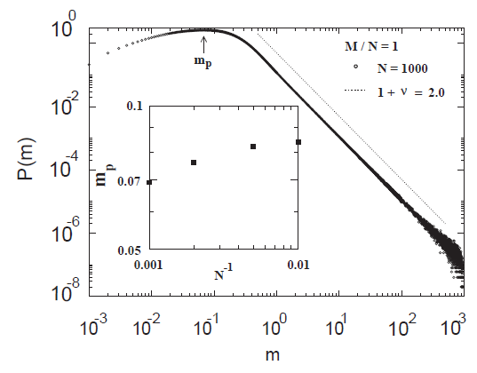
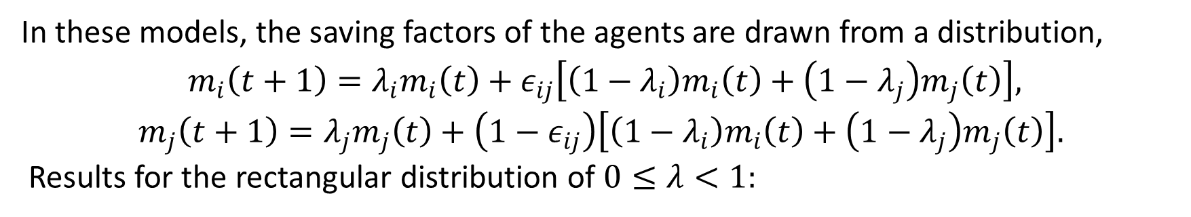
Models with Non-uniform Savings (1)
In these models, the saving factors of the agents are drawn from a distribution,
$m_{i}\left(t+1\right)=λ_{i}m_{i}\left(t\right)+ε_{ij}\left[\left(1−λ_{i}\right)m_{i}\left(t\right)+\left(1−λ_{j}\right)m_{j}\left(t\right)\right],$
$$m_{j}\left(t+1\right)=λ_{j}m_{j}\left(t\right)+\left(1−ε_{ij}\right)\left[\left(1−λ_{i}\right)m_{i}\left(t\right)+\left(1−λ_{j}\right)m_{j}\left(t\right)\right].$$
Results for the rectangular distribution of $0≤λ<1:$

Slide 25
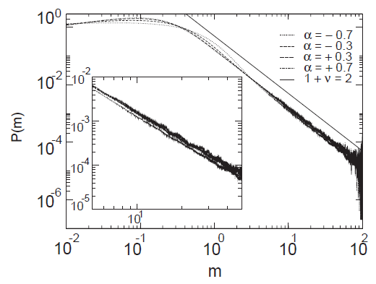
Models with Non-uniform Savings (2)
Results for the power law distribution $ρ(λ)∼λ^{α}$($0<λ<1$):
N = 100, M/N = 1

Slide 26
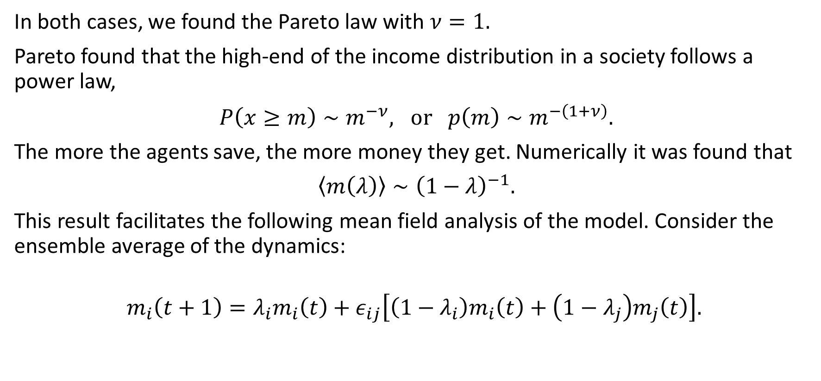
Mean-Field Approach (1)
In both cases, we found the Pareto law with $ν=1.$
Pareto found that the high-end of the income distribution in a society follows a power law,
$P\left(x≥m\right)∼m^{−ν}, or p\left(m\right)∼m^{−\left(1+ν\right)}.$
The more the agents save, the more money they get. Numerically it was found that
$〈m\left(λ\right)〉∼{\left(1−λ\right)}^{−1}.$
This result facilitates the following mean field analysis of the model. Consider the ensemble average of the dynamics:
$$m_{i}\left(t+1\right)=λ_{i}m_{i}\left(t\right)+ε_{ij}\left[\left(1−λ_{i}\right)m_{i}\left(t\right)+\left(1−λ_{j}\right)m_{j}\left(t\right)\right].$$

Slide 27
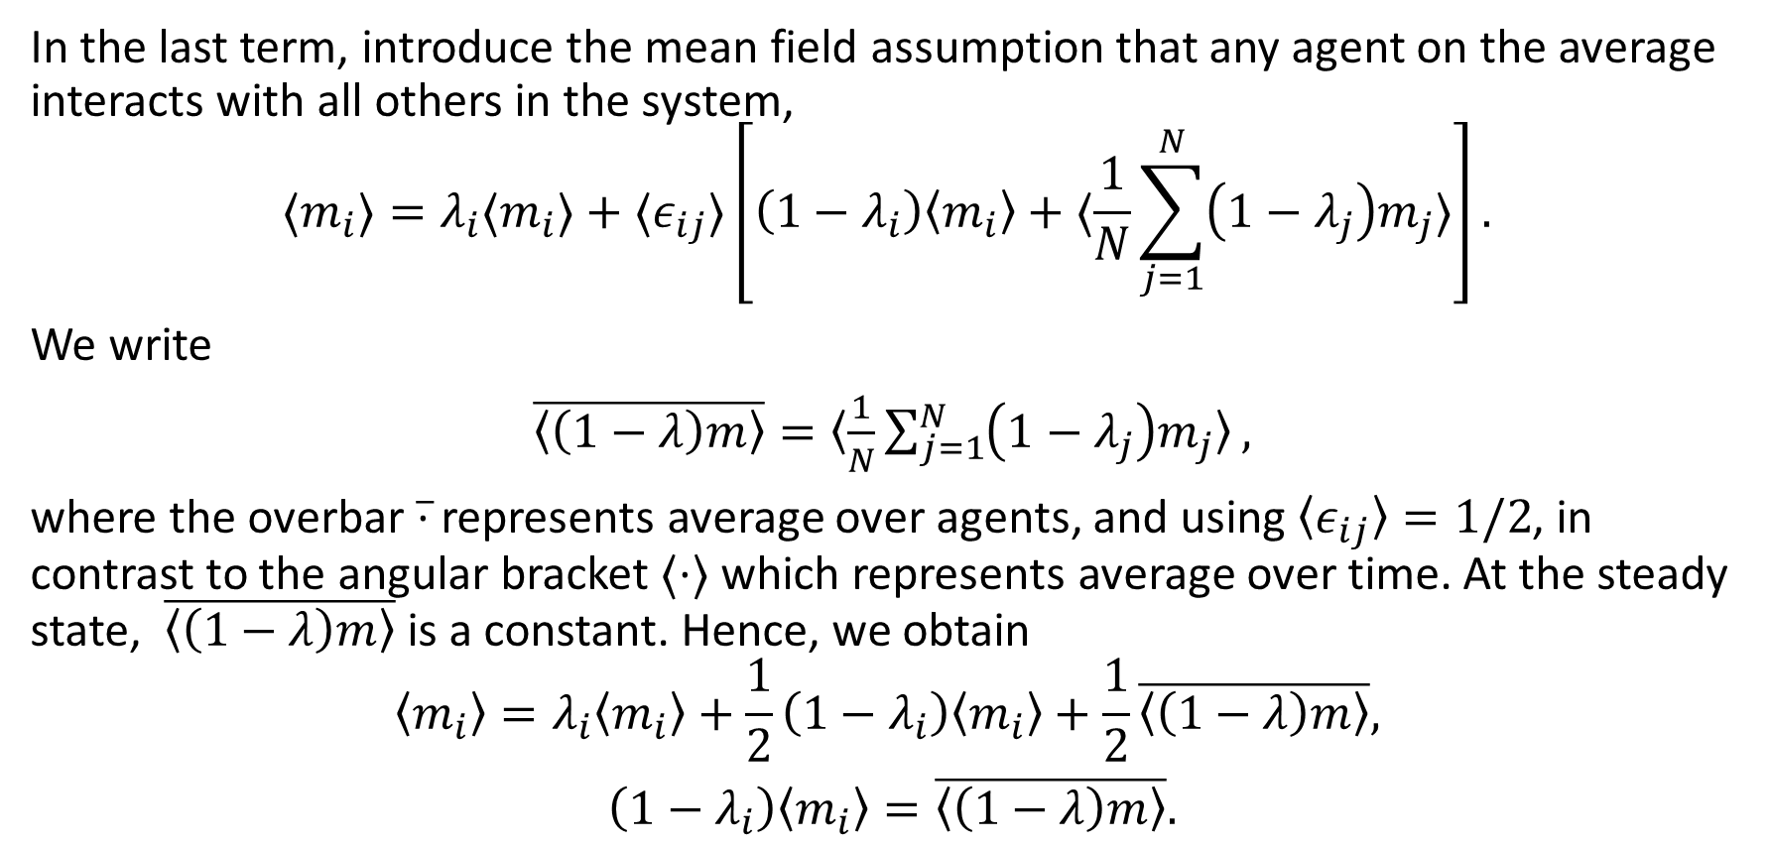
Mean-Field Approach (2)
In the last term, introduce the mean field assumption that any agent on the average interacts with all others in the system,
$$〈m_{i}〉=λ_{i}〈m_{i}〉+〈ε_{ij}〉\left[\left(1−λ_{i}\right)〈m_{i}〉+〈\frac{1}{N}\sum_{j=1}^{N}{\left(1−λ_{j}\right)m_{j}}〉\right].$$
We write
$\overline{〈\left(1−λ\right)m〉}=〈\frac{1}{N}\sum_{j=1}^{N}{\left(1−λ_{j}\right)m_{j}}〉,$
where the overbar $\overline{⋅}$ represents average over agents, and using $〈ε_{ij}〉=1/2$, in contrast to the angular bracket $〈⋅〉$ which represents average over time. At the steady state, $\overline{〈\left(1−λ\right)m〉}$ is a constant. Hence, we obtain
$$〈m_{i}〉=λ_{i}〈m_{i}〉+\frac{1}{2}\left(1−λ_{i}\right)〈m_{i}〉+\frac{1}{2}\overline{〈\left(1−λ\right)m〉},$$
$\left(1−λ_{i}\right)〈m_{i}〉=\overline{〈\left(1−λ\right)m〉}.$

Slide 28
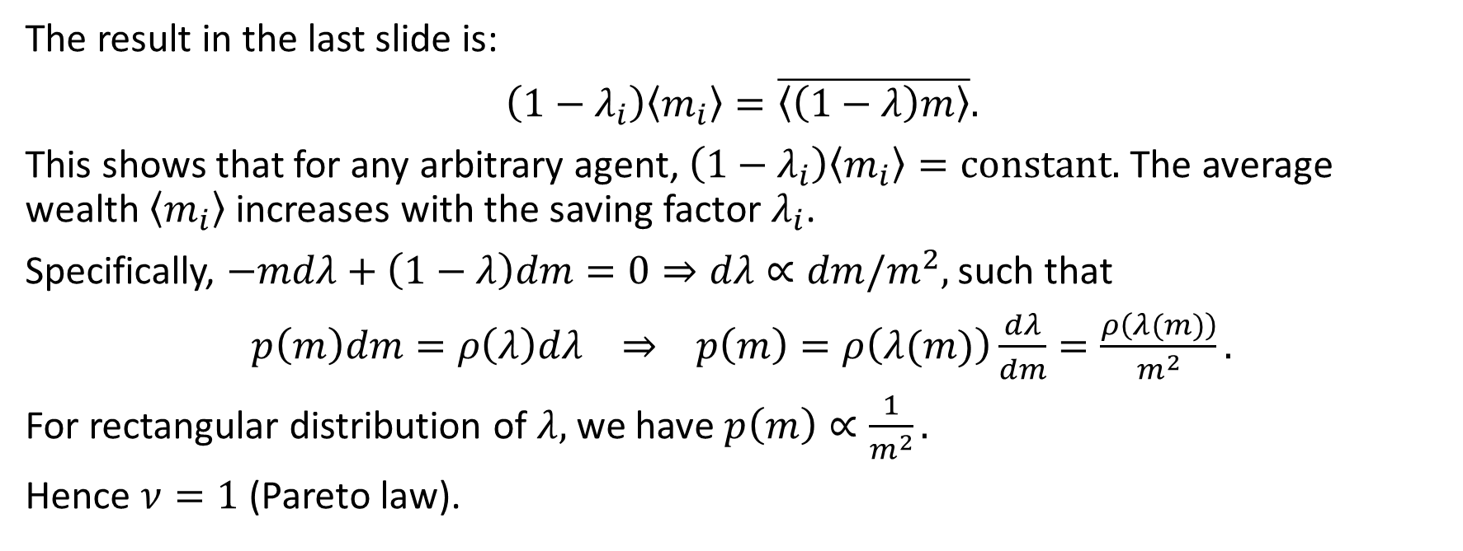
Mean-Field Approach (3)
The result in the last slide is:
$\left(1−λ_{i}\right)〈m_{i}〉=\overline{〈\left(1−λ\right)m〉}.$
This shows that for any arbitrary agent, $\left(1−λ_{i}\right)〈m_{i}〉=constant.$ The average wealth $〈m_{i}〉$ increases with the saving factor $λ_{i}$.
Specifically, $−mdλ+\left(1−λ\right)dm=0⇒dλ∝dm/m^{2},$ such that
$p\left(m\right)dm=ρ\left(λ\right)dλ ⇒ p\left(m\right)=ρ\left(λ(m)\right)\frac{dλ}{dm}=\frac{ρ\left(λ(m)\right)}{m^{2}}.$
For rectangular distribution of $λ,$ we have $p\left(m\right)∝\frac{1}{m^{2}}.$
Hence $ν=1$ (Pareto law).

Slide 29
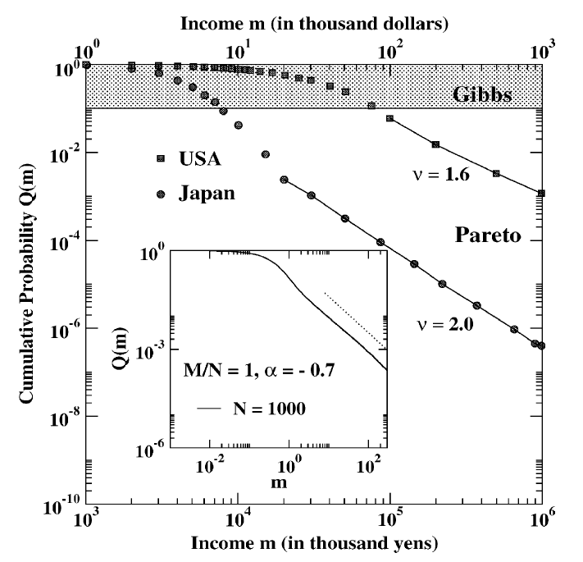
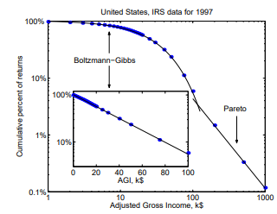
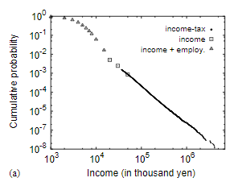
3. Comparison with Real Data^{3,4}
Low income range (>90% population): Gibbs-like distribution (exponential)
High income range (<10% population): Pareto-like distribution (power-law)
³ Drăgulescu AA and Yakovenko VM (2001) Statistical Mechanics of Money, Income, and Wealth: A Short Survey. Physica A 299 213.
⁴ Aoyama H, Souma W, and Fujiwara Y (2003) Growth and fluctuations of personal and company’s income. Physica A 324 352.

Slide 30
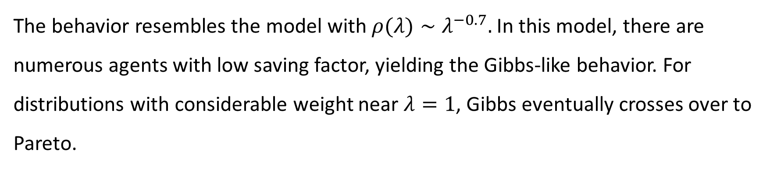
Resemblance with a Model
The behavior resembles the model with $ρ(λ)∼λ^{−0.7}.$In this model, there are numerous agents with low saving factor, yielding the Gibbs-like behavior. For distributions with considerable weight near $λ=1$, Gibbs eventually crosses over to Pareto.

Slide 31
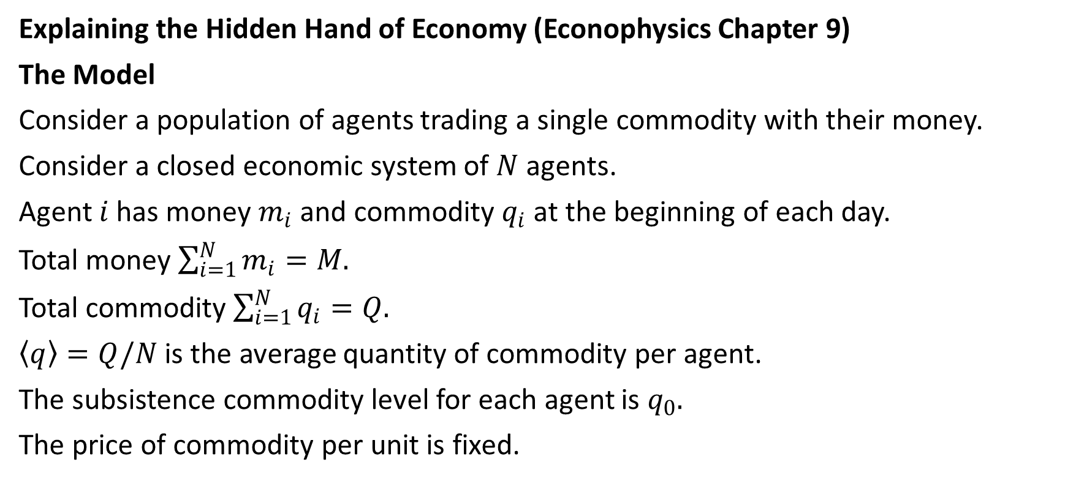
4. A Minimal Model of Interacting Selfish Agents⁵
Explaining the Hidden Hand of Economy (Econophysics Chapter 9)
The Model
Consider a population of agents trading a single commodity with their money.
Consider a closed economic system of $N$ agents.
Agent $i$ has money $m_{i}$ and commodity $q_{i}$ at the beginning of each day.
Total money $\sum_{i=1}^{N}{m_{i}}=M.$
Total commodity $\sum_{i=1}^{N}{q_{i}}=Q.$
$〈q〉=Q/N$ is the average quantity of commodity per agent.
The subsistence commodity level for each agent is $q_{0}.$
The price of commodity per unit is fixed.
⁵ Chakraborti A et al. (2001) A self-organising model of market with single commodity. Physica A 297 253–259.

Slide 32
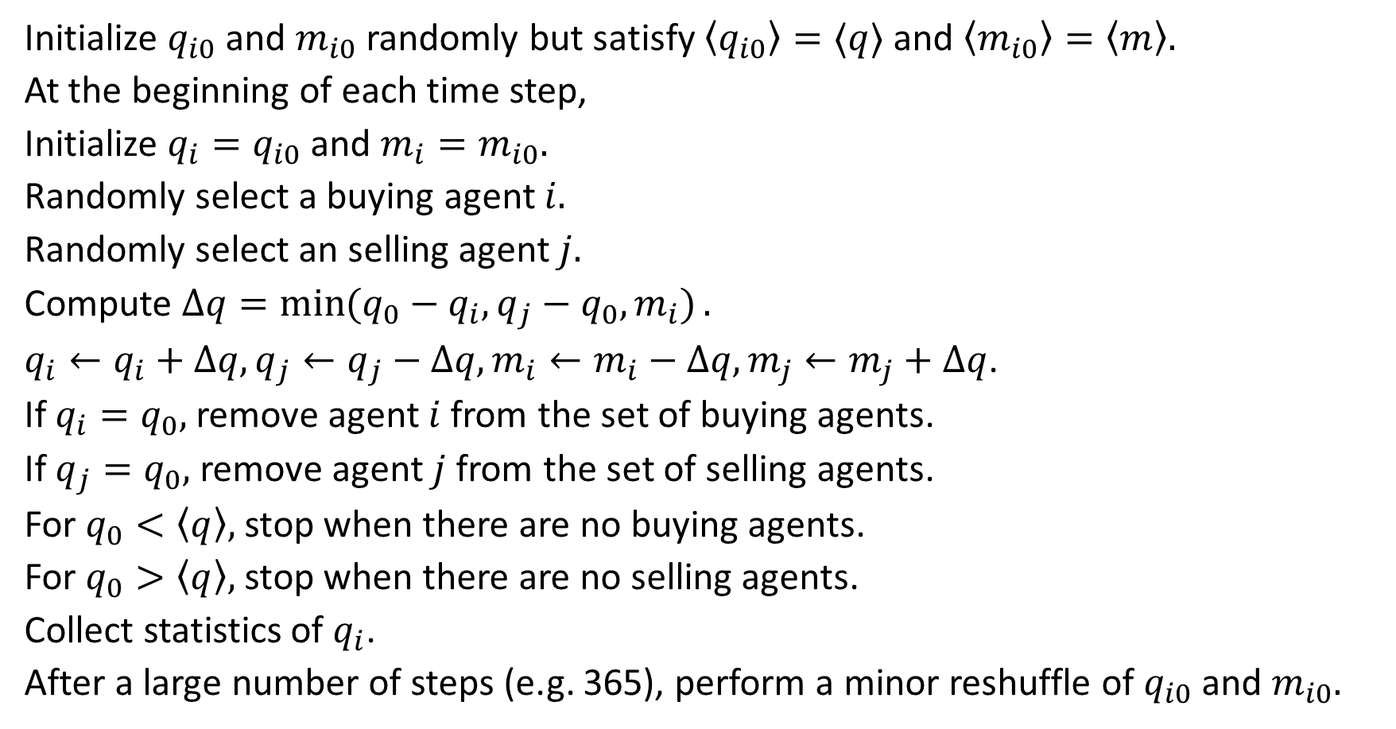
Algorithm
Initialize $q_{i0}$ and $m_{i0}$randomly but satisfy $〈q_{i0}〉=〈q〉$ and $〈m_{i0}〉=〈m〉.$
At the beginning of each time step,
Initialize $q_{i}=q_{i0}$ and $m_{i}=m_{i0}.$
Randomly select a buying agent $i.$
Randomly select an selling agent $j.$
Compute $Δq=\min{(q_{0}−q_{i},q_{j}−q_{0},m_{i})}.$
$q_{i}←q_{i}+Δq, q_{j}←q_{j}−Δq, m_{i}←m_{i}−Δq, m_{j}←m_{j}+Δq$.
If $q_{i}=q_{0},$ remove agent $i$ from the set of buying agents.
If $q_{j}=q_{0},$ remove agent $j$ from the set of selling agents.
For $q_{0}<〈q〉,$ stop when there are no buying agents.
For $q_{0}>〈q〉,$ stop when there are no selling agents.
Collect statistics of $q_{i}$.
After a large number of steps (e.g. 365), perform a minor reshuffle of $q_{i0}$ and $m_{i0}.$

Slide 33
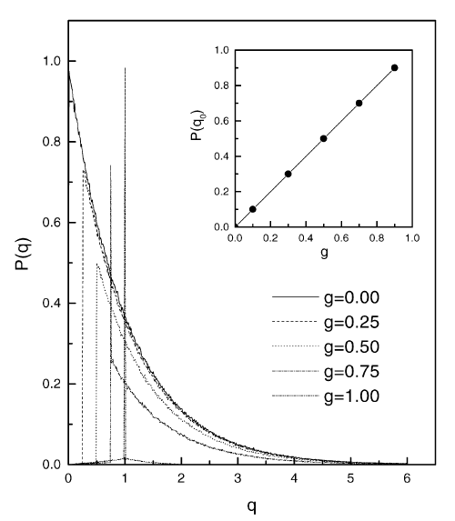

Unlimited Money Supply and Limited Supply of Commodity
$$g=\frac{q_{0}}{\left\langle q\right\rangle }.$$
Case 1: Satisfied case ($g<1)$
Commodity distribution after trading:
$$P\left(q\right)=\left\{\begin{matrix}delta function & q=q_{0}, \\ exponential function & q>q_{0}.\end{matrix}\right.$$

Slide 34
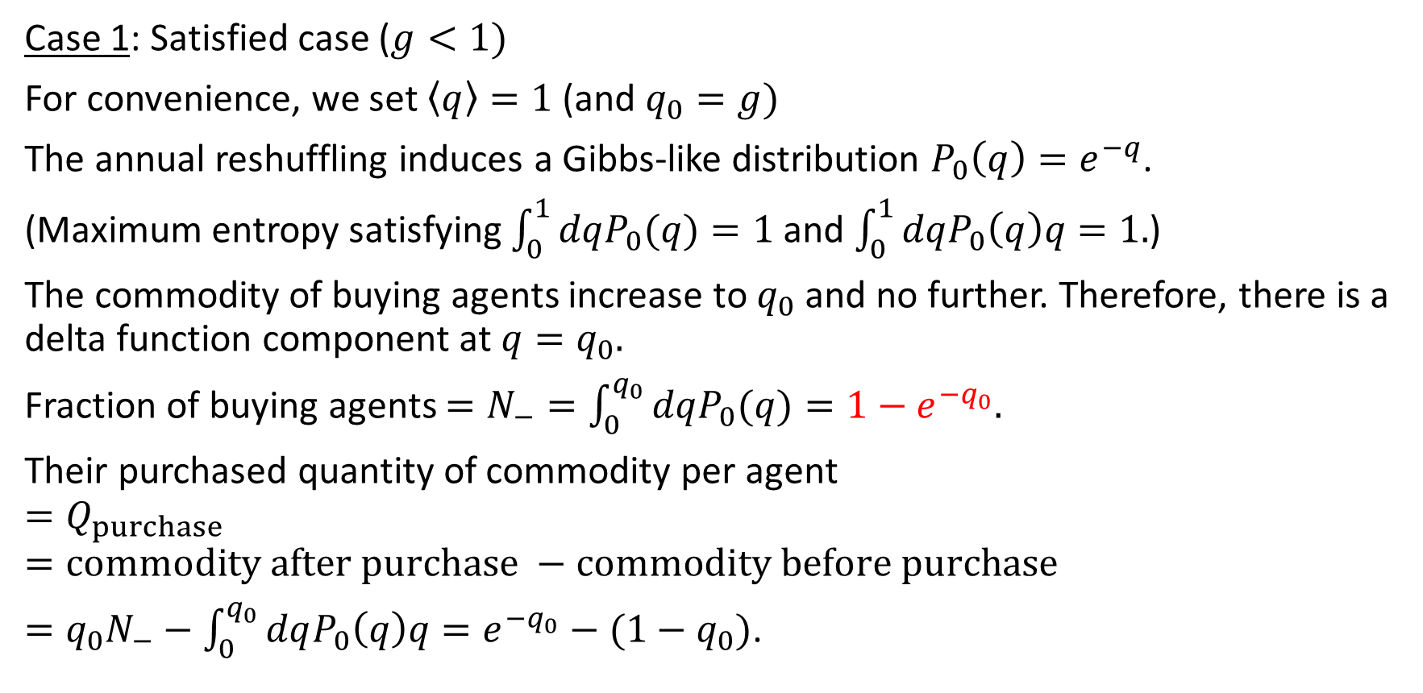

Buying Agents Ending Up with $q=q_{0}$
Case 1: Satisfied case ($g<1)$
For convenience, we set $〈q〉=1$ (and $q_{0}=g)$
The annual reshuffling induces a Gibbs-like distribution $P_{0}\left(q\right)=e^{−q}$.
(Maximum entropy satisfying $\int_{0}^{1}{dqP_{0}(q)}=1$ and $\int_{0}^{1}{dqP_{0}\left(q\right)q}=1.$)
The commodity of buying agents increase to $q_{0}$ and no further. Therefore, there is a delta function component at $q=q_{0}.$
Fraction of buying agents $=N_{−}=\int_{0}^{q_{0}}{dqP_{0}(q)}=1−e^{−q_{0}}.$
Their purchased quantity of commodity per agent
$$=Q_{purchase}$$
$$=commodity after purchase −commodity before purchase$$
$=q_{0}N_{−}−\int_{0}^{q_{0}}{dqP_{0}\left(q\right)q}=e^{−q_{0}}−(1−q_{0})$.

Slide 35
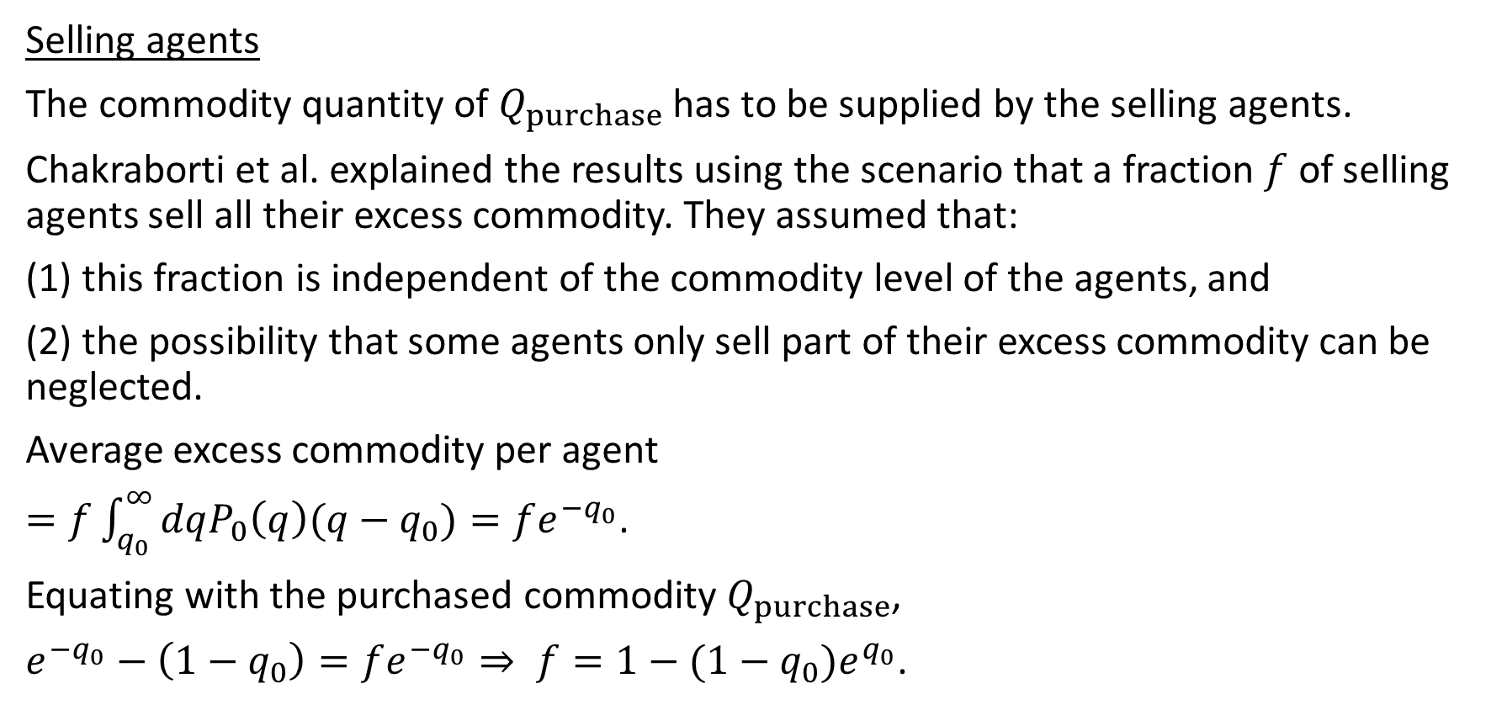

Selling Agents Ending Up with $q=q_{0}$ (1)
Selling agents
The commodity quantity of $Q_{purchase}$ has to be supplied by the selling agents.
Chakraborti et al. explained the results using the scenario that a fraction $f$ of selling agents sell all their excess commodity. They assumed that:
(1) this fraction is independent of the commodity level of the agents, and
(2) the possibility that some agents only sell part of their excess commodity can be neglected.
Average excess commodity per agent
$=f\int_{q_{0}}^{∞}{dqP_{0}\left(q\right)(q−q_{0})}=fe^{−q_{0}}$.
Equating with the purchased commodity $Q_{purchase}$,
$e^{−q_{0}}−\left(1−q_{0}\right)=fe^{−q_{0}}⇒ f=1−(1−q_{0})e^{q_{0}}$.

Slide 36
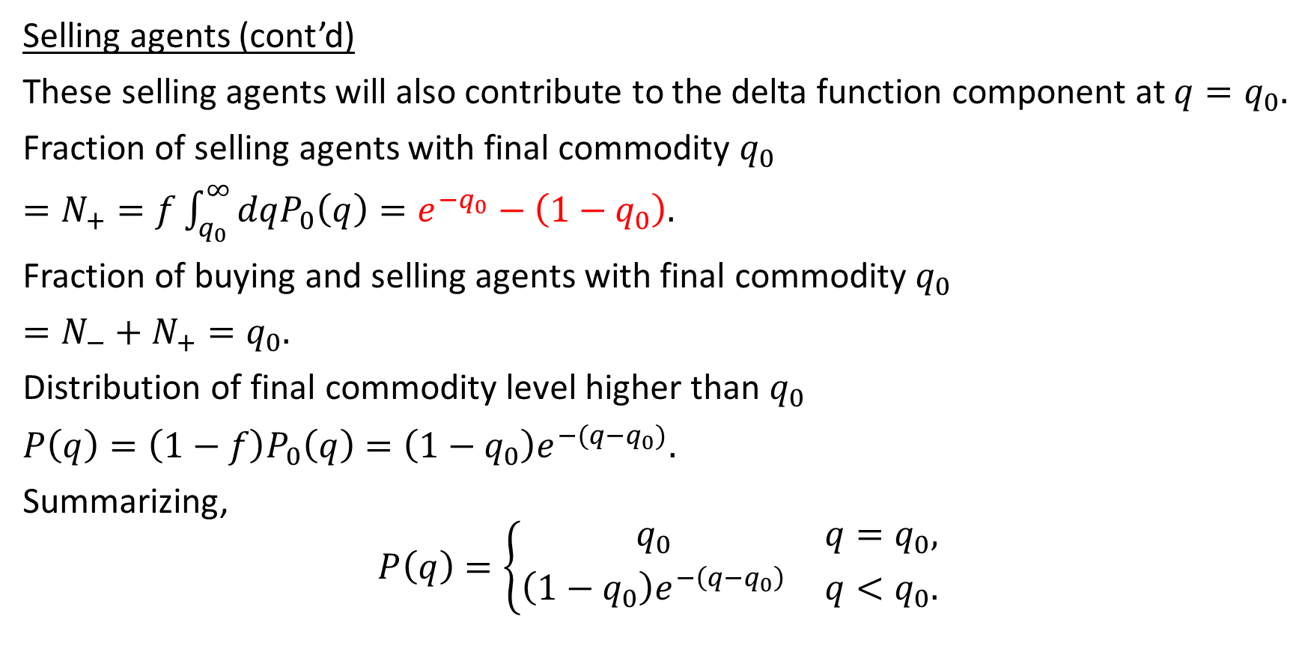

Selling Agents Ending Up with $q=q_{0}$ (2)
Selling agents (cont’d)
These selling agents will also contribute to the delta function component at $q=q_{0}.$
Fraction of selling agents with final commodity $q_{0}$
$=N_{+}=f\int_{q_{0}}^{∞}{dqP_{0}\left(q\right)}=e^{−q_{0}}−\left(1−q_{0}\right).$
Fraction of buying and selling agents with final commodity $q_{0}$
$=N_{−}+N_{+}=q_{0}.$
Distribution of final commodity level higher than $q_{0}$
$P\left(q\right)=\left(1−f\right)P_{0}\left(q\right)=\left(1−q_{0}\right)e^{−(q−q_{0})}.$
Summarizing,
$$P\left(q\right)=\left\{\begin{matrix}q_{0} & q=q_{0}, \\ \left(1−q_{0}\right)e^{−\left(q−q_{0}\right)} & q<q_{0}.\end{matrix}\right.$$

Slide 37
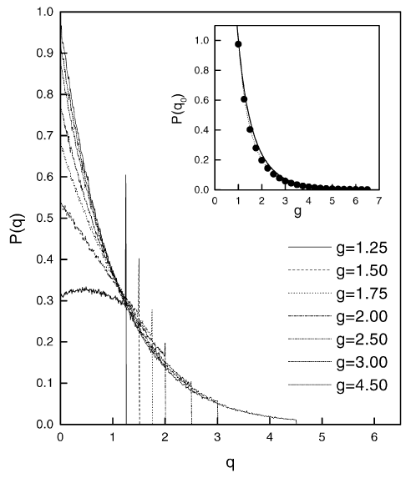


Case 2: Frustrated Case ($g>1$)
Case 1: Frustrated case ($g>1)$
Commodity distribution after trading:
$P\left(q\right)=\left\{\begin{matrix}delta function & q=q_{0}, \\ exponential function & q<q_{0}.\end{matrix}\right.$

Slide 38
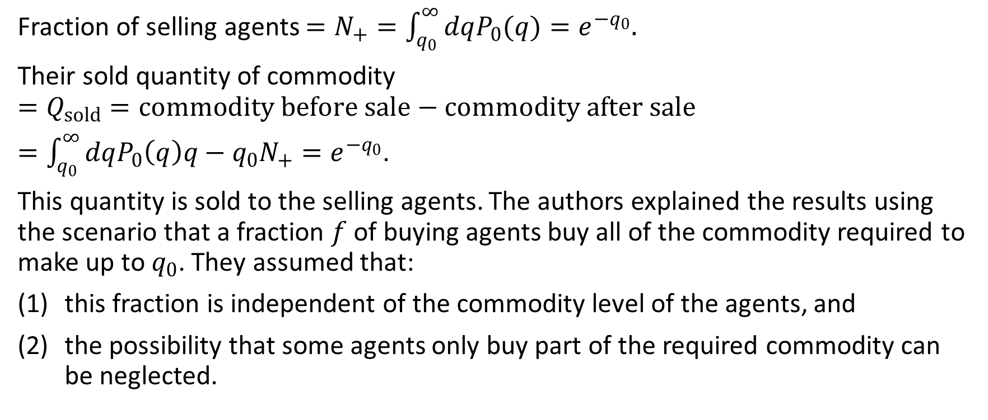

Selling Agents Ending Up with $q=q_{0}$
Fraction of selling agents $=N_{+}=\int_{q_{0}}^{∞}{dqP_{0}(q)}=e^{−q_{0}}.$
Their sold quantity of commodity
$$=Q_{sold}=commodity before sale−commodity after sale$$
$=\int_{q_{0}}^{∞}{dqP_{0}\left(q\right)q}−q_{0}N_{+}=e^{−q_{0}}$.
This quantity is sold to the selling agents. The authors explained the results using the scenario that a fraction $f$ of buying agents buy all of the commodity required to make up to $q_{0}$. They assumed that:
this fraction is independent of the commodity level of the agents, and
the possibility that some agents only buy part of the required commodity can be neglected.

Slide 39
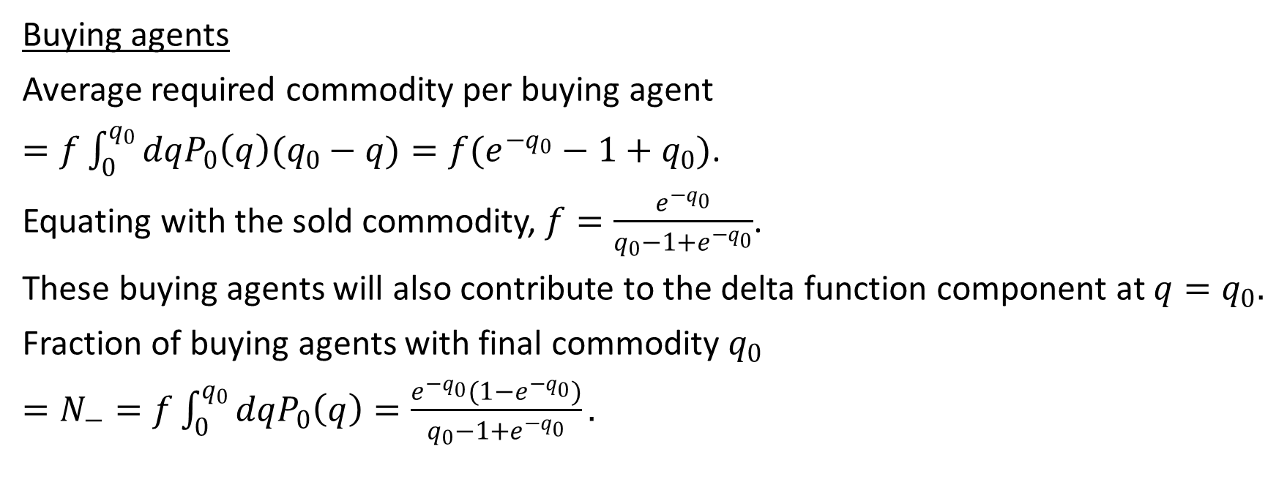
Buying Agents Ending Up with $q=q_{0}$
Buying agents
Average required commodity per buying agent
$=f\int_{0}^{q_{0}}{dqP_{0}\left(q\right)(q_{0}−q)}=f(e^{−q_{0}}−1+q_{0})$.
Equating with the sold commodity, $f=\frac{e^{−q_{0}}}{q_{0}−1+e^{−q_{0}}}$.
These buying agents will also contribute to the delta function component at $q=q_{0}.$
Fraction of buying agents with final commodity $q_{0}$
$=N_{−}=f\int_{0}^{q_{0}}{dqP_{0}\left(q\right)}=\frac{e^{−q_{0}}(1−e^{−q_{0}})}{q_{0}−1+e^{−q_{0}}}.$

Slide 40
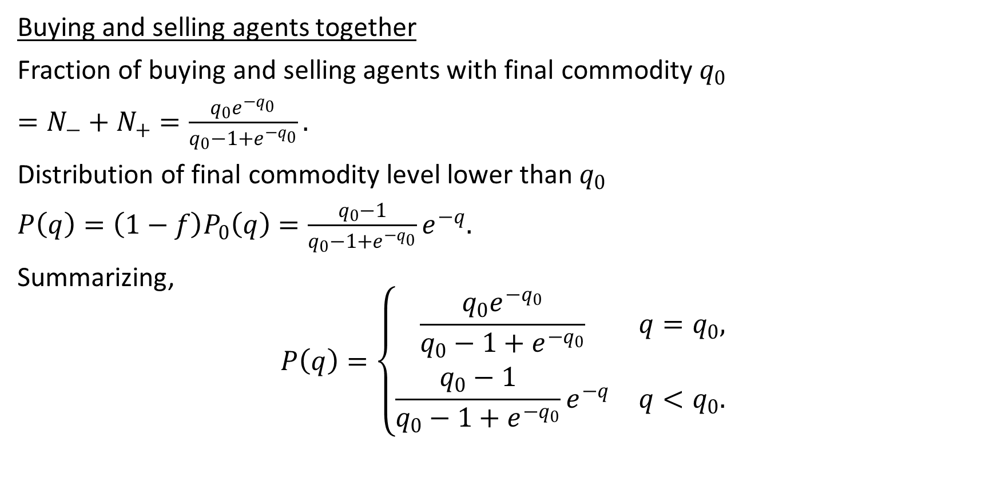

All Agents Ending Up with $q=q_{0}$
Buying and selling agents together
Fraction of buying and selling agents with final commodity $q_{0}$
$=N_{−}+N_{+}=\frac{q_{0}e^{−q_{0}}}{q_{0}−1+e^{−q_{0}}}.$
Distribution of final commodity level lower than $q_{0}$
$P\left(q\right)=\left(1−f\right)P_{0}\left(q\right)=\frac{q_{0}−1}{q_{0}−1+e^{−q_{0}}}e^{−q}.$
Summarizing,
$$P\left(q\right)=\left\{\begin{matrix}\frac{q_{0}e^{−q_{0}}}{q_{0}−1+e^{−q_{0}}} & q=q_{0}, \\ \frac{q_{0}−1}{q_{0}−1+e^{−q_{0}}}e^{−q} & q<q_{0}.\end{matrix}\right.$$

Slide 41
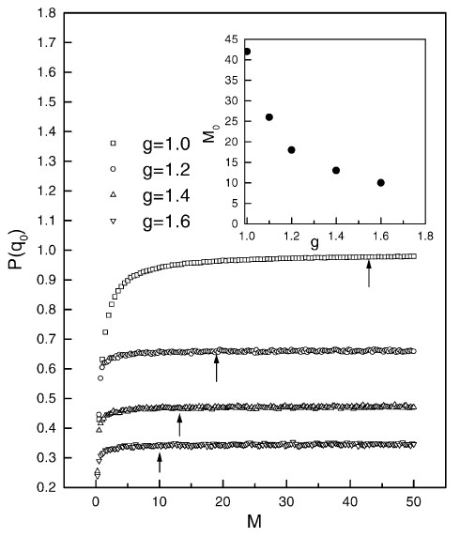

Limited Money Supply and Limited Supply of Commodity
When money supply is limited, some buying agents cannot have enough money to purchase the required quantity of commodity.
In the frustrated cases, the fraction of satisfied agents $P\left(q_{0}\right)$ decreases with the money supply $M$.
The minimum amount of money $M_{0}$ needed for the smooth functioning of the market depends on $g$.

